Slide 1

Airline Assistant
Submitted By:
Shweta Gupta (001523739)

Slide 2
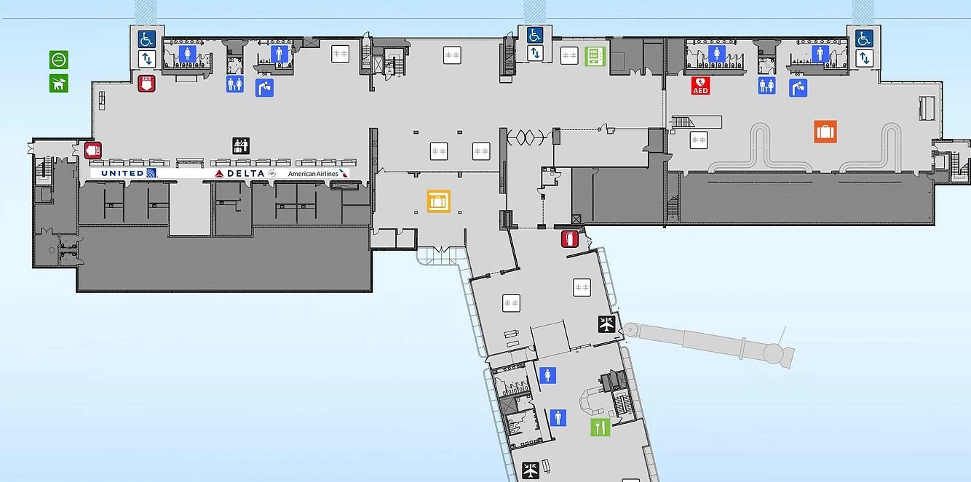




Overview
Airport Map
Notification
Help
Order Food
Personal Details
Airline Assistant

Slide 3

Affected Customer
Targeting people above 50 years.
Most of the time elderly people do not feel confident about traveling alone.
The journey becomes hectic if it has long layovers. So, at this situation

Slide 4




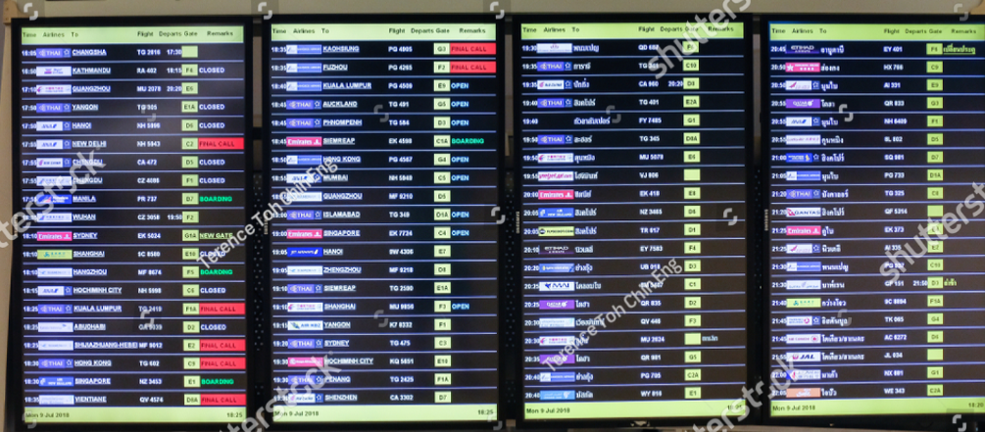
Customer Problems
Pacing
Language
Overburden of download
Hearing
Searching

Slide 5
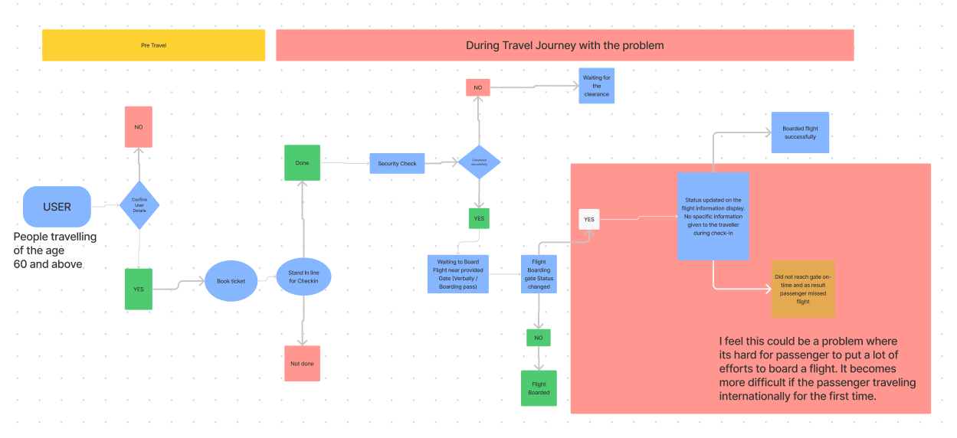
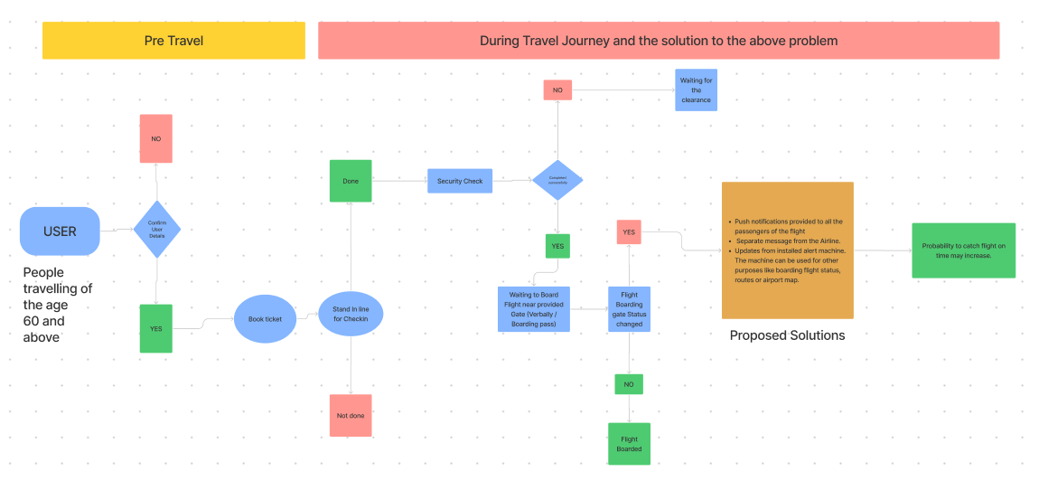
User Flow
This user flow shows the customer problem highlighted in the red box.
This situation is when elderly travels alone.
Common causes – flight status changes, boarding gate update on the 11th hour, layovers.
This user flow shows the proposed solution of the highlighted issue.
Centralized, user friendly, one stop destination
This may ease the travel both internationally and domestic.

Slide 6
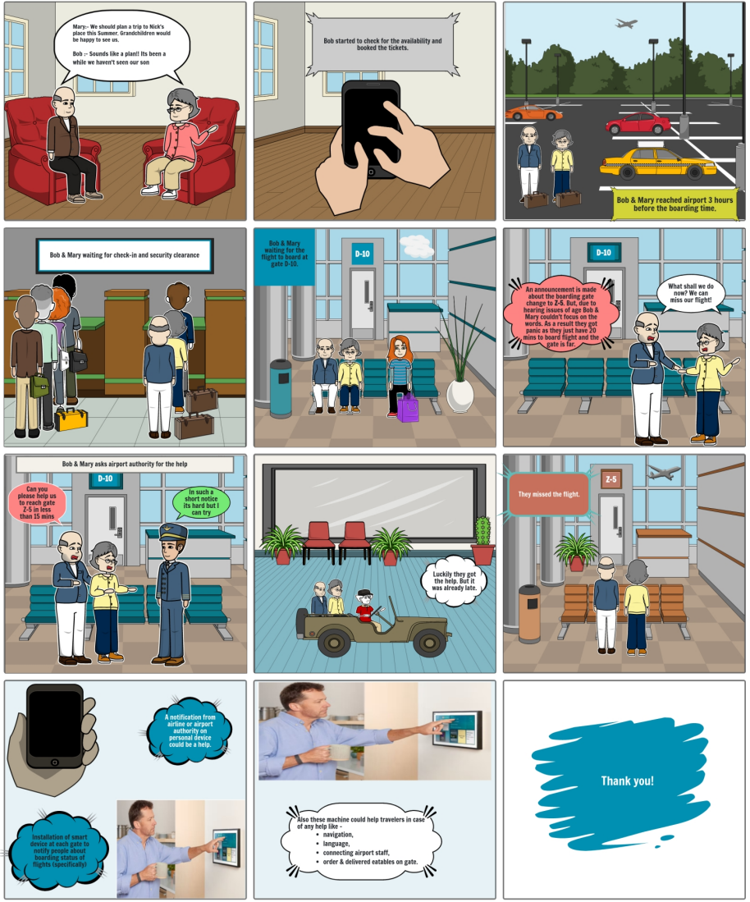
Story Board

Slide 7
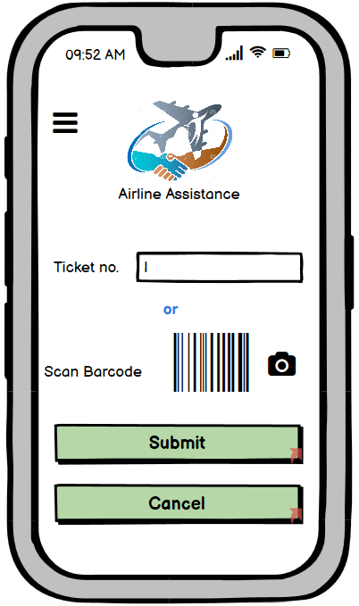
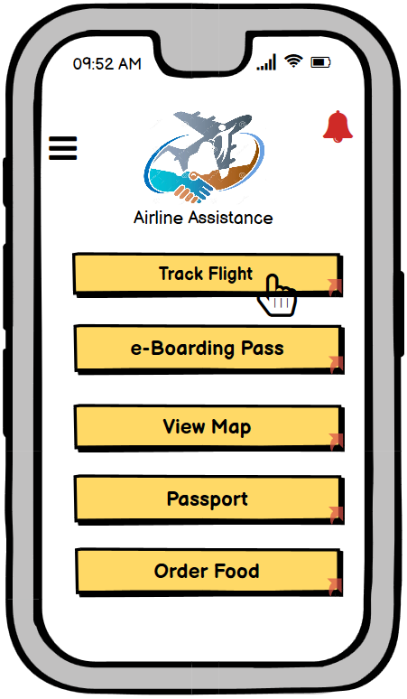
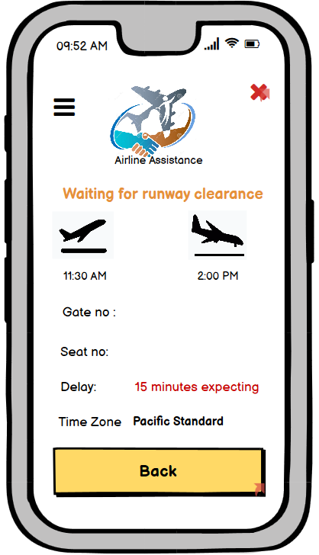
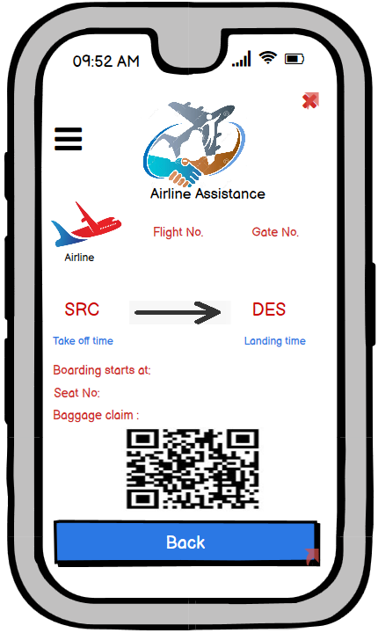
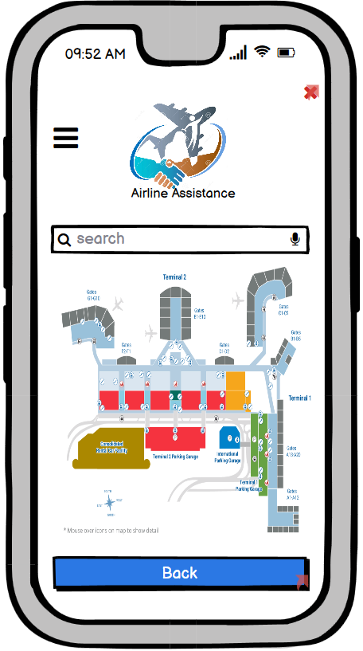
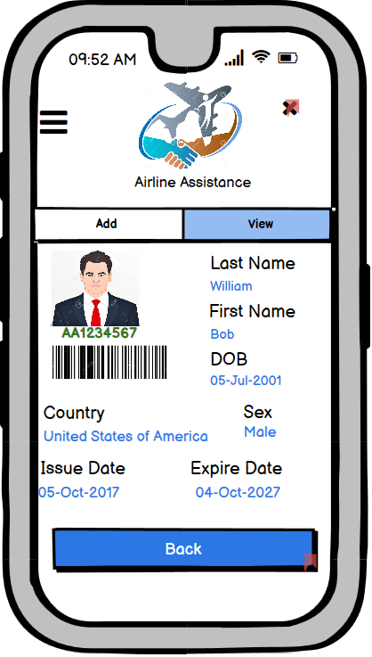
Lo-fi Wireframes
Above are a few important screen in Lo-Fi wireframe.

Slide 8
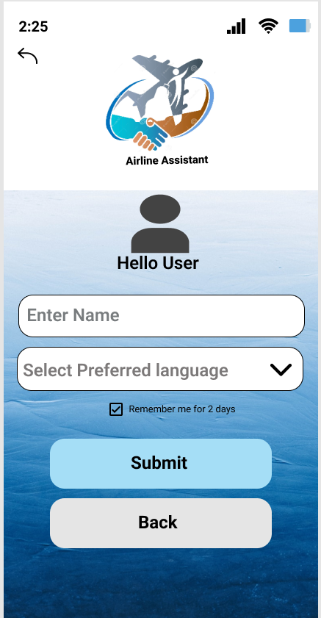
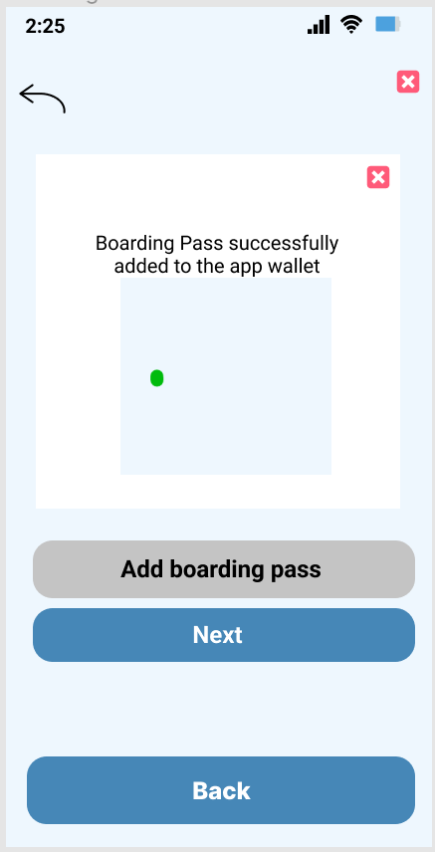
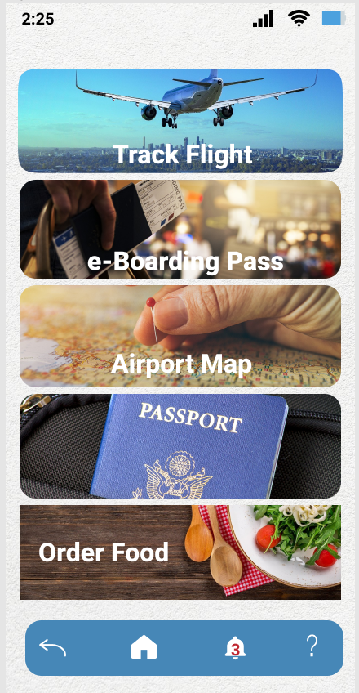
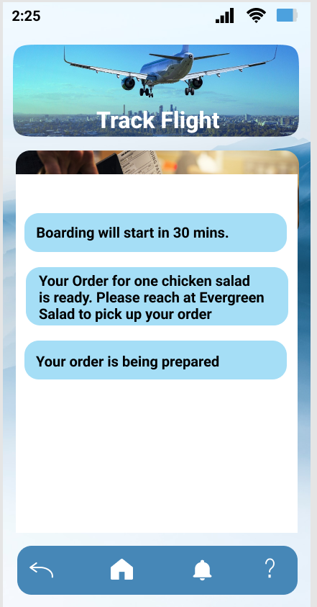
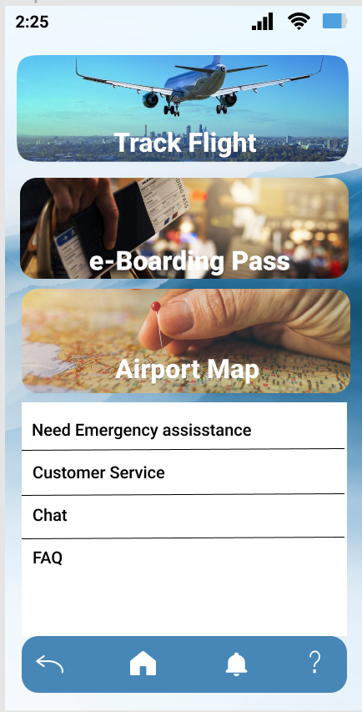
Hi-fi Wireframes
Above are a few important screen in Hi-Fi wireframe.

Slide 9
User Testing
Contributor 1 Feedback-
Fonts are big enough to read, for elderly
Easy flow of actions in the prototype.
One stop destination is helpful
Contributor 2 Feedback-
Addition of passport is good but also interested in how it can be added.
Addition of map is interesting but also locate the user’s current location.
Increase font for gate no. more. Overall great application
Add some helping texts for directions or to make it more convenient for elderly
Contributor 3 Feedback-
The logo of app goes well with the application.
Help option to get the medical assistance is plus point especially to elderly.
https://app.usertesting.com/h/Vghbng2dYxYz4HFTwCRP?shared_via=link

Slide 10
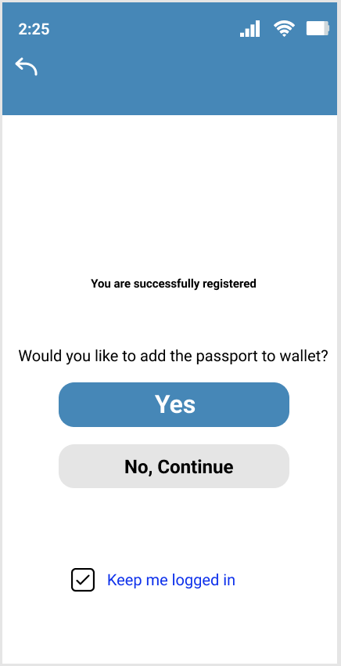
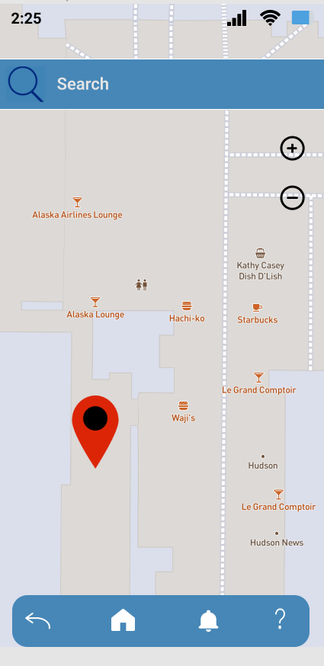
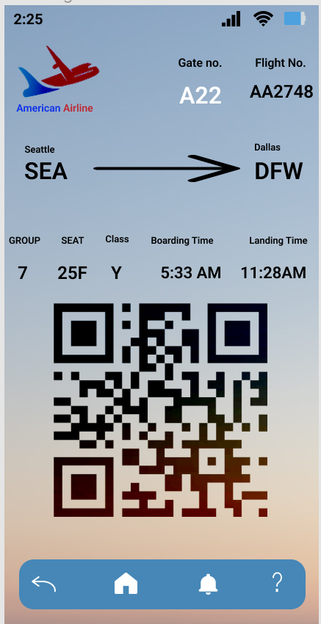
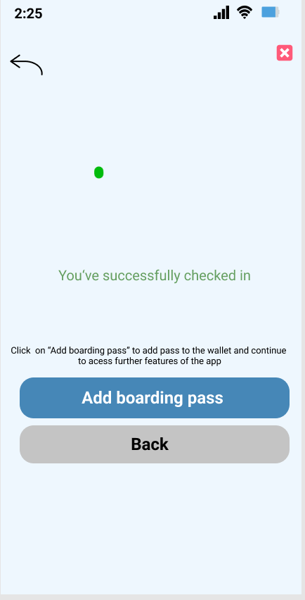
Improvement
Addition of passport
Locate user
Highlighted Gate no. with bigger font
Added some helping texts as above

Slide 11
Conclusion
Airline Assistant entirely focusing on making the elderly life easy on travelling across the world.
Centralized system makes this application more efficient.
Notification about current situation like flight status, meal order status will keep user updated.
Do not have to worry about carrying ID proof (conditional to countries approval).

Slide 12

THANK YOU

